Slide 1
Abnormal uterine bleeding
Dr. Thilina S Palihawadana
Reproductive system (Phase II)

Slide 2
Learning outcomes
Be able to
Define what is “Abnormal uterine bleeding”
Discuss the causes of abnormal uterine bleeding.
Work out a differential diagnosis for a patient with AUB.
Develop an investigation plan in AUB.
Decide on a treatment plan for a patient with AUB

Slide 3
Abnormal uterine bleeding
Any variation from the normal menstrual cycle.
Described using
Volume
Regularity
Frequency
Duration
Other

Slide 4
Abnormal uterine bleeding

Slide 5
Abnormal uterine bleeding
Volume
Only subjective measurement
Use of indirect evidence
Deviations from the usual, effect on the daily living

Slide 6
Abnormal uterine bleeding
Regularity
The length of the bleeding free interval
(Normal variation ± 2 to 20 days)

Slide 7
Abnormal uterine bleeding
Frequency
The frequency of menstrual bleeding
Every 24-38 days considered as normal

Slide 8
Abnormal uterine bleeding
Duration
The duration of bleeding in a menstrual period
3-8 days considered as normal

Slide 9
Abnormal uterine bleeding
Other associated abnormalities
Non-menstrual bleeding that is present
May be in association with abnormal or normal menstrual bleeding

Slide 10
Other terminologies used

Slide 11
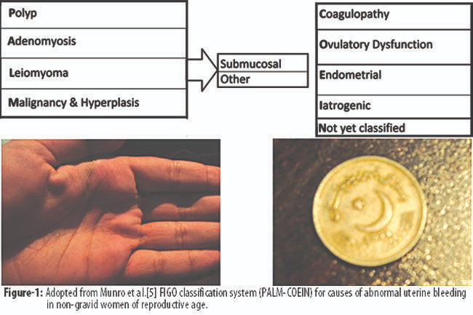
Causes of Abnormal uterine bleeding
Structural or Non-structural (PALM COEIN classification)

Slide 12
Clinical evaluation
Symptom analysis
Ovulatory AUB – regular, dysmenorrhea, PMS
Anovulatory AUB – irregular, infrequent
Heavy (normal E2.) Light (low E2)
Intermenstrual bleeding – polyp, malignancy or hyperplasia

Slide 13
Clinical evaluation
Symptoms suggestive of anemia
Sexual and reproductive history
(contraception, risk of STI, fertility wishes
Impact on social and sexual functioning and quality of life
Symptoms suggestive of systemic causes
hypothyroidism, hyperprolactinemia, coagulation disorders, polycystic ovary syndrome, adrenal or hypothalamic disorders
Associated symptoms such as vaginal discharge or odour
Pelvic pain or pressure – pelvic masses

Slide 14
Clinical evaluation
Vital signs and Weight/BMI
Thyroid exam
Skin exam (pallor, bruising, striae, hirsutism, petechiae)
Abdominal exam (mass, hepatosplenomegaly)
Gynaecological examination:
Inspection: vulva, vagina, cervix, Bimanual examination of uterus and adnexal structures
Testing: Pap smear, cervical cultures if risk for sexually transmitted infection

Slide 15
Investigations
Full blood count
Coagulation profile – only if from menarche or there is positive family history.
Thyroid profile – only if sym & signs suggestive
Imaging – Ultrasound
Premenopausal endometrium 4-16mm.
Focal lesions
Saline infusion sonohysetrography
Good in detection of masses like polyp, fibroids

Slide 16
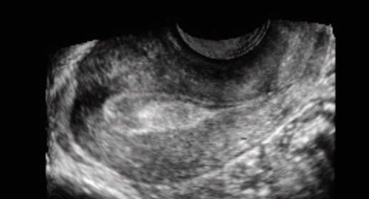
Investigations
Full blood count
Coagulation profile – only if from menarche or there is positive family history.
Thyroid profile – only if sym & signs suggestive
Imaging – Ultrasound
Premenopausal endometrium 4-16mm.
Focal lesions
Saline infusion sonohysetrography
Good in detection of masses like polyp, fibroids

Slide 17
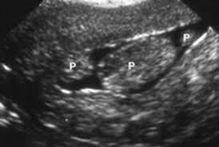
Investigations
Full blood count
Coagulation profile – only if from menarche or there is positive family history.
Thyroid profile – only if sym & signs suggestive
Imaging – Ultrasound
Premenopausal endometrium 4-16mm.
Focal lesions
Saline infusion sonohysetrography
Good in detection of masses like polyp, fibroids

Slide 18

Investigations
Full blood count
Coagulation profile – only if from menarche or there is positive family history.
Thyroid profile – only if sym & signs suggestive
Imaging – Ultrasound
Premenopausal endometrium 4-16mm.
Focal lesions
Saline infusion sonohysetrography
Good in detection of masses like polyp, fibroids
Hysteroscopy

Slide 19
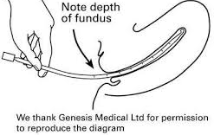
Endometrial assessment and biopsy
Endometrial aspiration
Good pick up rate for Endometrial cancer (>90%)
Hysteroscopy guided biopsy
When focal lesions are detected on USS

Slide 20
Endometrial assessment and biopsy
Indications for endometrial biopsy
Age > 40
Risk factors for endometrial cancer
Failure of medical treatment
Significant intermenstrual bleeding
Risk of endometrial malignancy or premalignant conditions
Age, Obesity (BMI > 30 kg/m2), Nulliparity, PCOS, Diabetes
HNPCC (Hereditary nonpolyposis colorectal cancer)

Slide 21
Treatment of AUB
Medical
Non-hormonal
Non-steroidal anti-inflammatory drugs
Antifibrinolytics
Hormonal
Combined hormonal contraceptives
Levonorgestrel-releasing intrauterine system
Oral progestins (long phase, days 5 to 26)
Depot-medroxyprogesterone acetate
Danazol
GnRH-agonists

Slide 22
Treatment of AUB
Surgical
Specific
Hysteroscopic polypectomy
Myomectomy
Non-specific
endometrial ablation
hysterectomy

Slide 23
Treatment of AUB
Indications for surgical treatment
failure to respond to medical therapy,
inability to utilize medical therapies (i.e. side effects, contraindications)
significant anaemia
impact on quality of life
concomitant uterine pathology (large uterine fibroids, endometrial hyperplasia).

